Slide 1
Midsem presentation

Slide 2
agenda
Datasets
Preprocessing
Models used
Analysis
Time complexity
Explainable AI-Lime Tool

Slide 3
Datasets used
UNSW_NB15 –features:44, classes selected:5
2018_Iot_attacks_dataset –features:77 classes selected :11
(https://kaggle.com/code/ekkykharismadhany/dataset-checking)

Slide 4
preprocessing

Slide 5
Tecniques
Min-Max Scaler- converts the values into the range of 0 to 1
Feature selection:-PCA(Principal component analysis)- helps to select the highly correlated features through the correlation matrix
Encoding categorical Features
Deleting redundant features
Sampling

Slide 6
sampling
Sampling was performed for the datasets to handle the class imbalance for both the datasets, thereby solving one of the limitations of this paper

Slide 7
Feature selection
UNSW_NB15
Total: 77 features
After this technique: reduced to 19 features(after implementing feature reduction and removing redundant features, based on PCA)
2018_newdataset
Total: 44 features
After this technique: reduced to 8 features(after implementing feature reduction and removing redundant features, based on PCA)

Slide 8
Models used
Machine learning models
KNN
Decision Tree
Support Vector Regression(svm)
Deep Learning Models
Deep Neural Networks
1D CNN
Feed Forward Neural Network

Slide 9
Dl models
For these models, the data was first converted to tensor format and then the models were trained on these datasets .
The Feed Forward Neural Network has been chosen since it has proven to be a better performing model compared to the 2D CNN mentioned in the paper.

Slide 10
Analysis of models

Slide 11
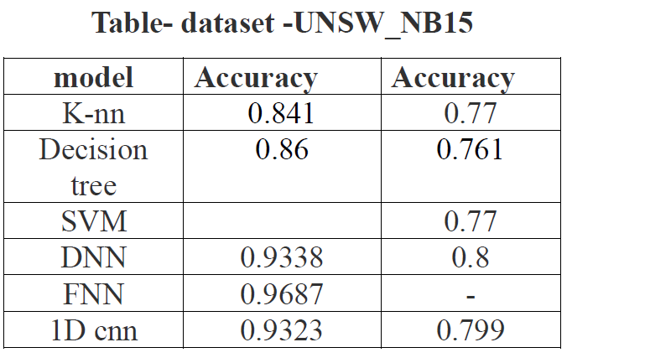

Slide 12
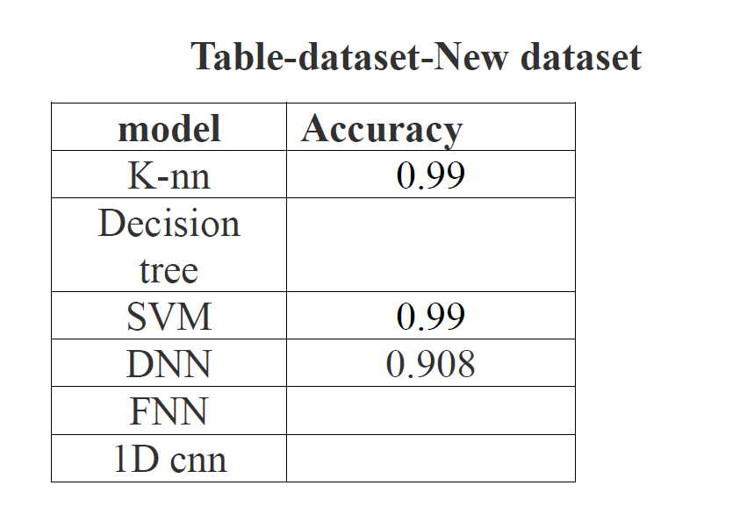





.

Slide 13
Time complexity of FNN
According to the code, there are two loops that determine the time complexity:
Data Loading:
-_ _ len_ _(MyCustomDataset)- called only once per epoch to get the dataset size
-_ _getitem_ _(“ “)-called for each batch of data during training and evaluation. Here also, the time complexity is O(1).
Training Loop:
-Outer loop iterates for num_epochs
-inner loop iterates over the train loader , processing a batch of data in each iteration . The number of
iterations in this loop depends on the size of the training dataset and the batch size
Dominant one here is the Training Loop over the training data
Overall time complexity proportional to the size if the training dataset, thereby given by
O(len(train_dataset))

Slide 14
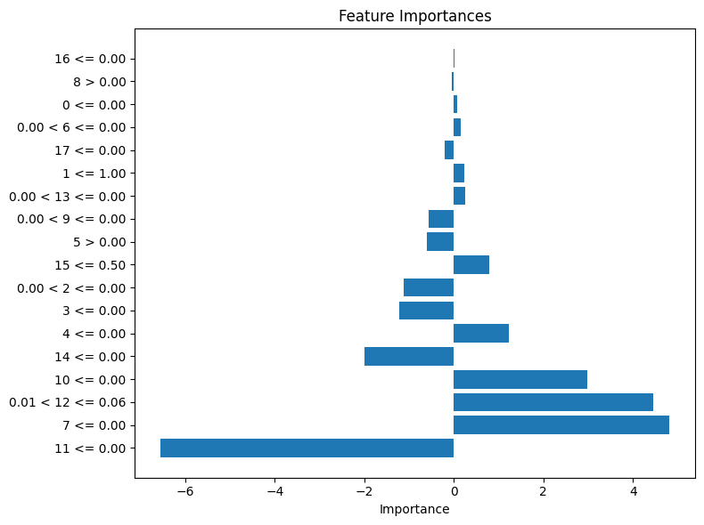
Lime tool-NEW DATASET

Slide 15
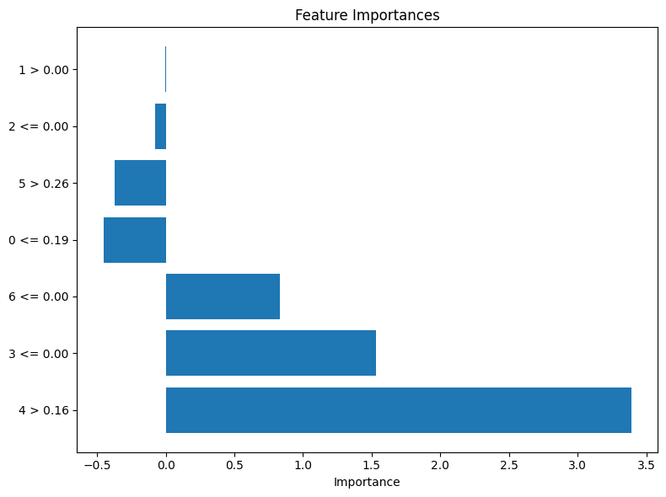
Lime tool-UNSW_NB15

Slide 16
Thankyou

